Slide 1
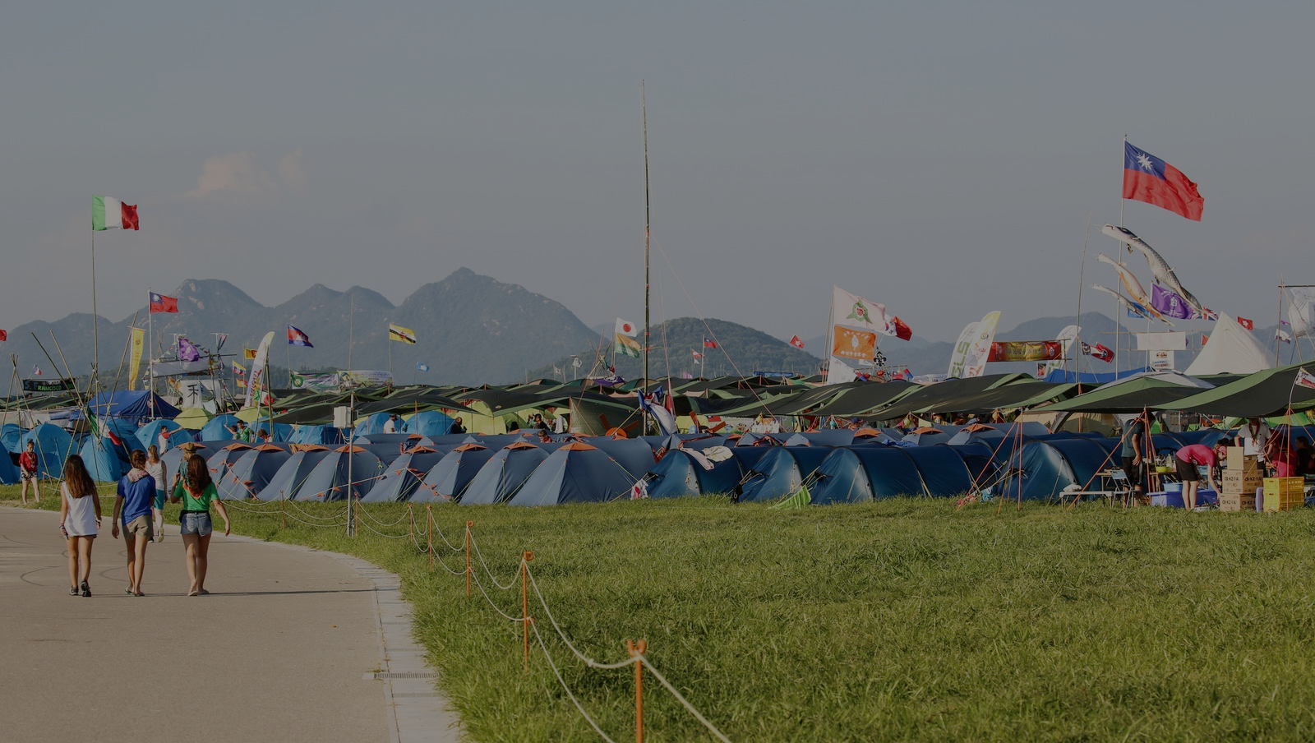


Aligning the
Youth Programme
with education for the sustainable development goals (SDGs)
Notes:
Creating a Better World: Enabling Global Citizens for the Sustainable Development Goals

Slide 2
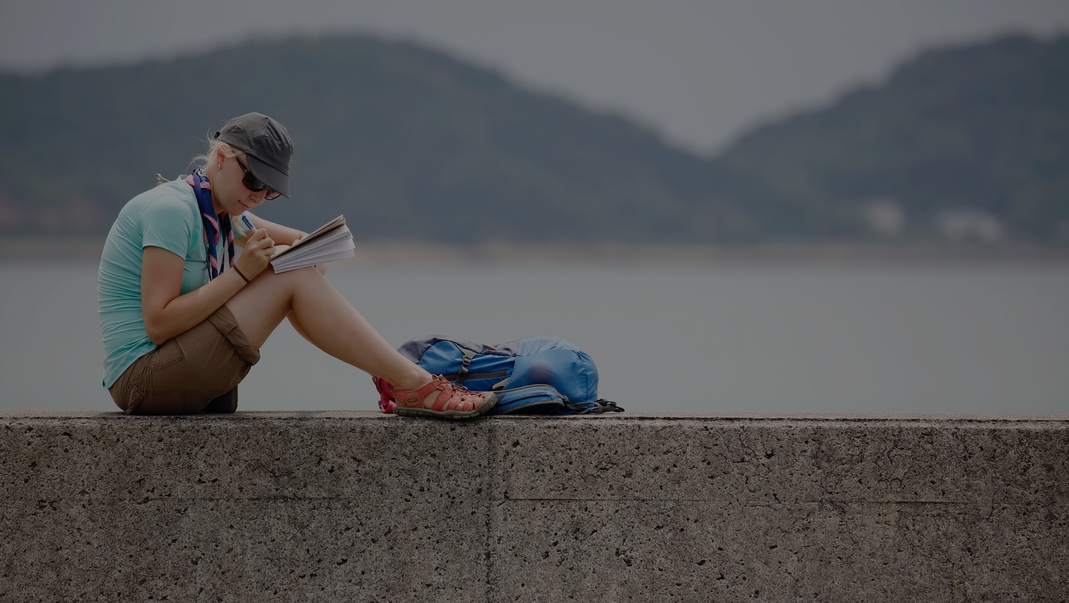


Align the Youth Programme with the SDGs
2
ways to contribute
to the SDGs
Implement the Better World Framework
Notes:
Sustainable development is commonly defined as “development that meets the needs of the present without compromising the ability of future generations to meet their own needs.” This was proposed in the Brundtland report.

Slide 3












Slide 4
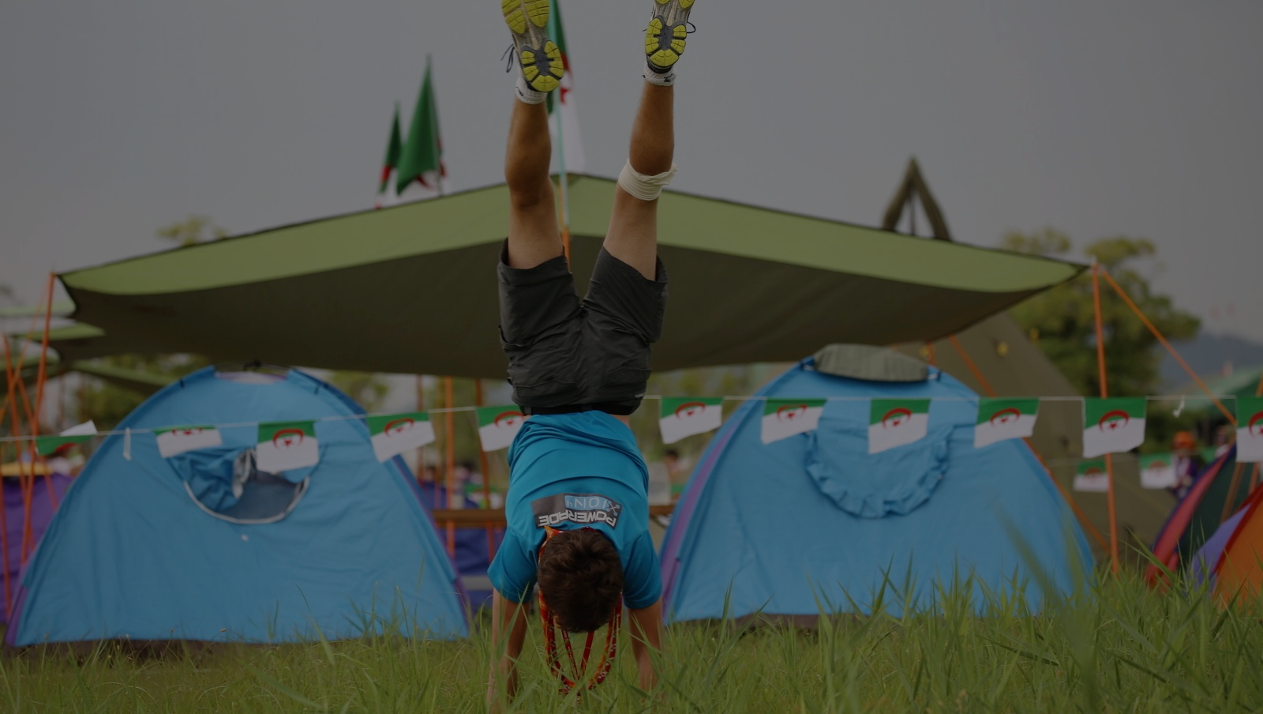
Contributing to the SDGs through the Youth Programme

Slide 5
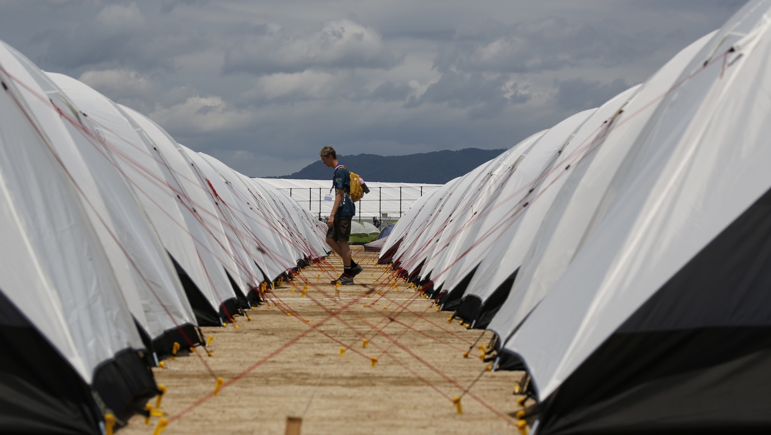

What do we mean by
“align with the SDGs”?
To look at Scouting’s educational proposal through the lens of the SDGs
Notes:
Sustainable development is commonly defined as “development that meets the needs of the present without compromising the ability of future generations to meet their own needs.” This was proposed in the Brundtland report.

Slide 6
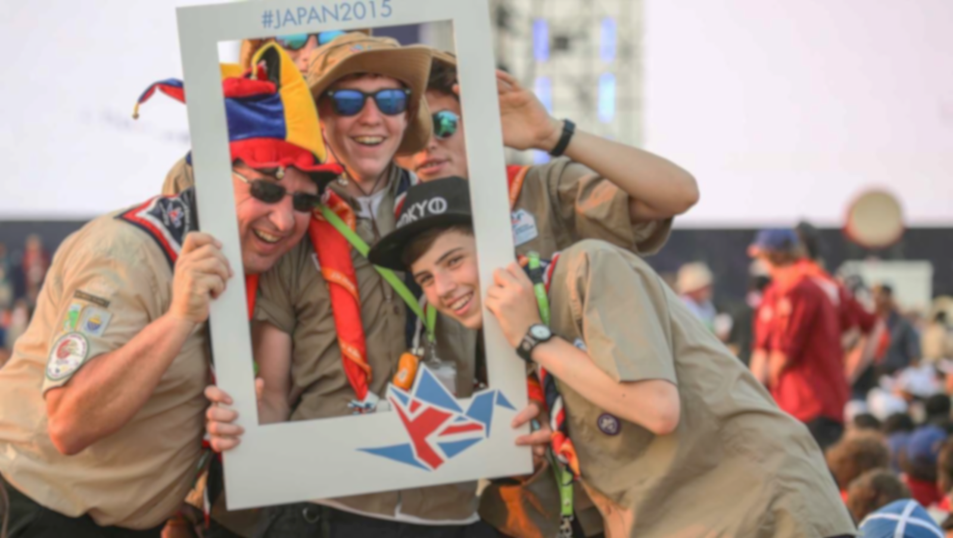
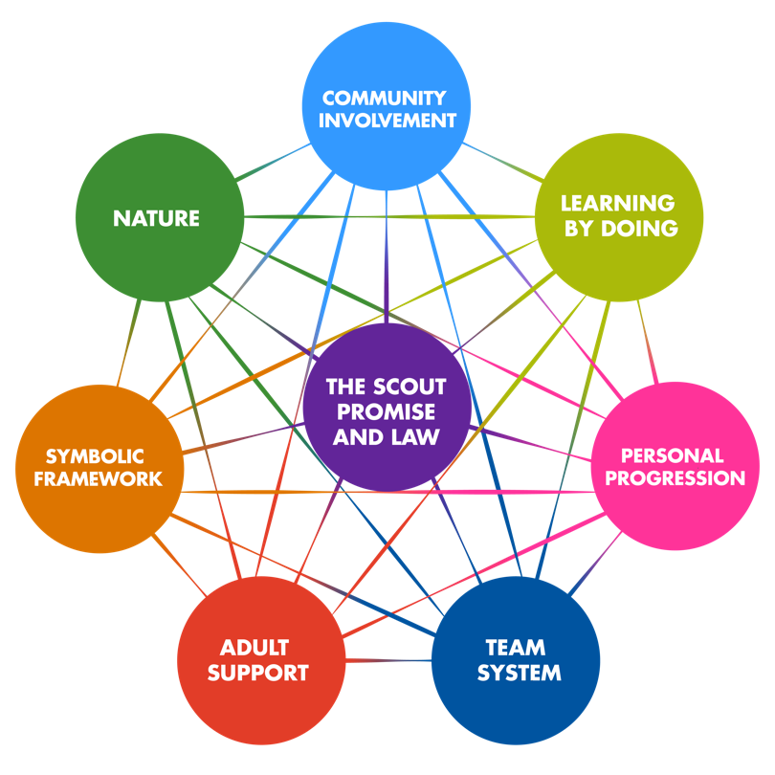
How the SDGs are linked
to Scouting
Notes:
In terms of education
Scouting contributes to the development of young people so that they can be active global citizens that create positive change in their communities. It does so by responding to the diverse needs and aspirations of young people in over 224 countries and territories. As such, it is a movement deeply embedded in the local communities in which it exists and, therefore, is in a prime place to understand and tackle the issues that are brought forward in the SDGs.
In terms of the organisation
The SDGs are fully aligned with the Mission of Scouting to “… help build a better world where people are self-fulfilled as individuals and play a constructive role in society.” Additionally, Scouting’s Vision 2023 aims to further develop the Scout Movement as “the leading educational youth movement”, focused on “enabling 100 million young people by 2023 to be active citizens creating positive changes in their communities and in the world.”
Growing to 100 million means as well providing more young people with the opportunity to enjoy learning experiences in a community of values to develop the needed competencies for sustainable development. Therefore, working towards contributing to the SDGs is a key towards achieving Scouting’s Vision and Mission and lives up to the legacy of over 110 years for the Scout Movement in contributing to peace and development.
See WOSM’s Constitution and Strategic Plan for Vision 2023.
Extra info (how SDGs link to the elements of the scout method)
The scout promise and law provide a ground of shared values for living together and encourages young people to voluntarily commit to promote local, national and international peace, understanding and cooperation, as well as to participate in the development of society;
Learning by doing enable people not only to understand an issue, but to develop the competencies and the will to take action on it;
The team system develops cooperation in tackling large issues that couldn’t be tackled alone;
Community involvement fosters engagement with the challenges of the society we live in, participation on its betterment, and commitment to and appreciation of the people around us;
Nature as a reference is an extraordinary setting to challenge ourselves and to connect to the planet and to the inner life;
The SDGs come with their own symbolic framework, which reinforces the value based symbolism of Scouting;
Adult support provides the needed intergenerational dialogue and assists the Scouts in understanding the complexity of the issues at hand; and
The personal progression ensures that the role and contribution of each Scout develops from project to project to build the competencies for sustainable development, from the local to the global levels.

Slide 7
THE MISSION
The Mission of Scouting is to contribute to the education of young people, through a value system based on the Scout Promise and Law, to help build a better world where people are self-fulfilled as individuals and play a constructive role in society.
How the SDGs are linked
to Scouting
Notes:
In terms of education
Scouting contributes to the development of young people so that they can be active global citizens that create positive change in their communities. It does so by responding to the diverse needs and aspirations of young people in over 224 countries and territories. As such, it is a movement deeply embedded in the local communities in which it exists and, therefore, is in a prime place to understand and tackle the issues that are brought forward in the SDGs.
In terms of the organisation
The SDGs are fully aligned with the Mission of Scouting to “… help build a better world where people are self-fulfilled as individuals and play a constructive role in society.” Additionally, Scouting’s Vision 2023 aims to further develop the Scout Movement as “the leading educational youth movement”, focused on “enabling 100 million young people by 2023 to be active citizens creating positive changes in their communities and in the world.”
Growing to 100 million means as well providing more young people with the opportunity to enjoy learning experiences in a community of values to develop the needed competencies for sustainable development. Therefore, working towards contributing to the SDGs is a key towards achieving Scouting’s Vision and Mission and lives up to the legacy of over 110 years for the Scout Movement in contributing to peace and development.
See WOSM’s Constitution and Strategic Plan for Vision 2023.
Extra info (how SDGs link to the elements of the scout method)
The scout promise and law provide a ground of shared values for living together and encourages young people to voluntarily commit to promote local, national and international peace, understanding and cooperation, as well as to participate in the development of society;
Learning by doing enable people not only to understand an issue, but to develop the competencies and the will to take action on it;
The team system develops cooperation in tackling large issues that couldn’t be tackled alone;
Community involvement fosters engagement with the challenges of the society we live in, participation on its betterment, and commitment to and appreciation of the people around us;
Nature as a reference is an extraordinary setting to challenge ourselves and to connect to the planet and to the inner life;
The SDGs come with their own symbolic framework, which reinforces the value based symbolism of Scouting;
Adult support provides the needed intergenerational dialogue and assists the Scouts in understanding the complexity of the issues at hand; and
The personal progression ensures that the role and contribution of each Scout develops from project to project to build the competencies for sustainable development, from the local to the global levels.

Slide 8
THE VISION
By 2023 Scouting will be the world’s leading educational youth movement, enabling 100 million young people to be active citizens creating positive change in their communities and in the world based on shared values.
How the SDGs are linked
to Scouting
Notes:
In terms of education
Scouting contributes to the development of young people so that they can be active global citizens that create positive change in their communities. It does so by responding to the diverse needs and aspirations of young people in over 224 countries and territories. As such, it is a movement deeply embedded in the local communities in which it exists and, therefore, is in a prime place to understand and tackle the issues that are brought forward in the SDGs.
In terms of the organisation
The SDGs are fully aligned with the Mission of Scouting to “… help build a better world where people are self-fulfilled as individuals and play a constructive role in society.” Additionally, Scouting’s Vision 2023 aims to further develop the Scout Movement as “the leading educational youth movement”, focused on “enabling 100 million young people by 2023 to be active citizens creating positive changes in their communities and in the world.”
Growing to 100 million means as well providing more young people with the opportunity to enjoy learning experiences in a community of values to develop the needed competencies for sustainable development. Therefore, working towards contributing to the SDGs is a key towards achieving Scouting’s Vision and Mission and lives up to the legacy of over 110 years for the Scout Movement in contributing to peace and development.
See WOSM’s Constitution and Strategic Plan for Vision 2023.
Extra info (how SDGs link to the elements of the scout method)
The scout promise and law provide a ground of shared values for living together and encourages young people to voluntarily commit to promote local, national and international peace, understanding and cooperation, as well as to participate in the development of society;
Learning by doing enable people not only to understand an issue, but to develop the competencies and the will to take action on it;
The team system develops cooperation in tackling large issues that couldn’t be tackled alone;
Community involvement fosters engagement with the challenges of the society we live in, participation on its betterment, and commitment to and appreciation of the people around us;
Nature as a reference is an extraordinary setting to challenge ourselves and to connect to the planet and to the inner life;
The SDGs come with their own symbolic framework, which reinforces the value based symbolism of Scouting;
Adult support provides the needed intergenerational dialogue and assists the Scouts in understanding the complexity of the issues at hand; and
The personal progression ensures that the role and contribution of each Scout develops from project to project to build the competencies for sustainable development, from the local to the global levels.

Slide 9
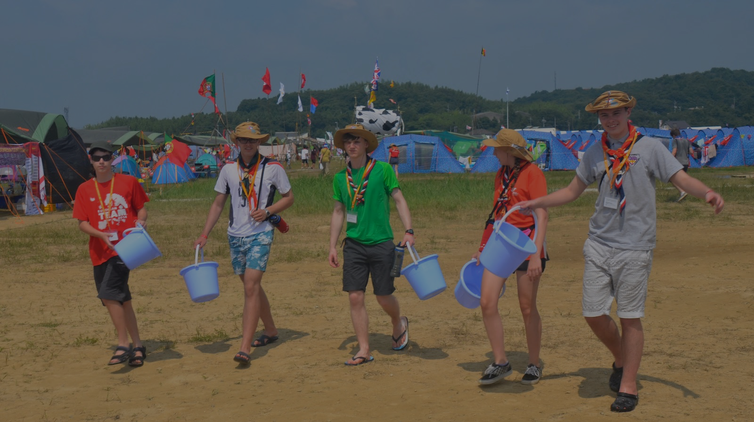
allows every human being to acquire the knowledge, skills, attitudes, and values necessary to shape a sustainable future
involves incorporating key sustainable development issues into teaching and learning
Education for Sustainable Development
Sustainability education is often referred to as education for sustainable development (ESD)
UNESCO, 2014
Notes:
Sustainability Education is often referred to as Education for Sustainable Development (ESD), which has been defined as:
UNESCO, 2014
"Education for Sustainable Development allows every human being to acquire the knowledge, skills, attitudes, and values necessary to shape a sustainable future.”
Education for Sustainable Development means including key sustainable development issues into teaching and learning; for example, climate change, disaster risk reduction, biodiversity, poverty reduction, and sustainable consumption.
It also requires participatory teaching and learning methods that motivate and empower learners to change their behaviour and take action for sustainable development. Education for Sustainable Development consequently promotes competencies like critical thinking, imagining future scenarios, and making decisions in a collaborative way.
Education for Sustainable Development requires far-reaching changes in the way education is often practised today."

Slide 10
participatory teaching and learning methods that motivate and empower learners to change their behaviour and take action
consequently promotes competencies like critical thinking, imagining future scenarios, and making decisions in a collaborative way
Education for Sustainable Development
Sustainability education is often referred to as education for sustainable development (ESD)
UNESCO, 2014
Notes:
Sustainability Education is often referred to as Education for Sustainable Development (ESD), which has been defined as:
UNESCO, 2014
"Education for Sustainable Development allows every human being to acquire the knowledge, skills, attitudes, and values necessary to shape a sustainable future.”
Education for Sustainable Development means including key sustainable development issues into teaching and learning; for example, climate change, disaster risk reduction, biodiversity, poverty reduction, and sustainable consumption.
It also requires participatory teaching and learning methods that motivate and empower learners to change their behaviour and take action for sustainable development. Education for Sustainable Development consequently promotes competencies like critical thinking, imagining future scenarios, and making decisions in a collaborative way.
Education for Sustainable Development requires far-reaching changes in the way education is often practised today."

Slide 11
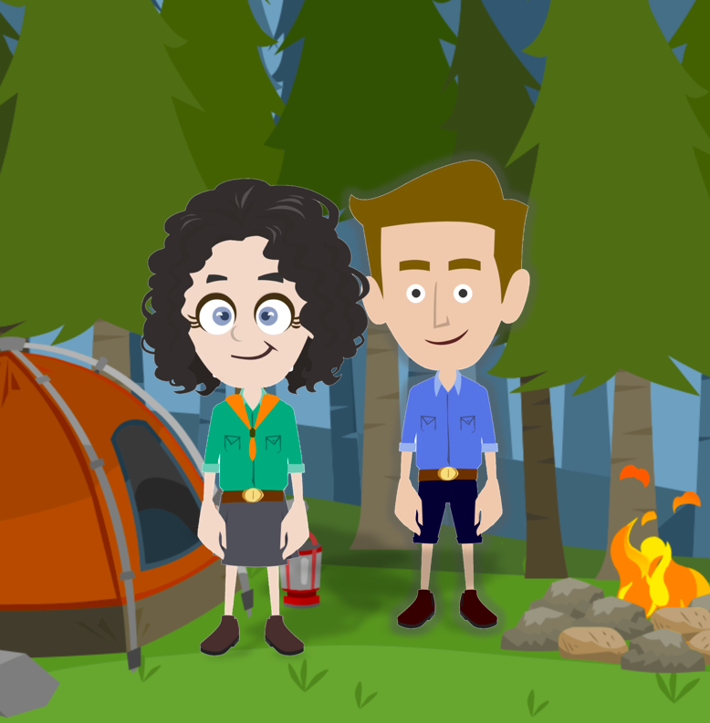
SCOUTS Global Active Citizen
Key competencies for sustainable development
Can solve complex problems
Can strategically develop and implement innovative actions
Collaborates with others
Is self-aware
Thinks in systems to see the big picture
Anticipates what can happen in the future
Shows critical thinking
Understands and reflects on underlying values and norms
AUTONOMOUS
SUPPORTIVE
RESPONSIBLE
COMMITTED
CULTURALLY SENSITIVE
Notes:
UNESCO developed in 2017, a resource entitled “Education for Sustainable Development Goals; Learning Objectives” as part of its Global Action Programme on Education for Sustainable Development. It sets up the agenda for education for the SDGs by looking at what knowledge and skills young people need in order to successfully promote sustainable development. We are not talking here about reinventing the educational proposal of Scouting, but strengthening it by taking into consideration key competencies for sustainability into our programming.
Education for Sustainable Development describes a set of key competencies that are identified as important to engage constructively and responsibly in today’s societies. “The sustainability key competencies represent what sustainability citizens need to deal with today’s complex challenges. They are relevant to all SDGs and also enable individuals to relate the different SDGs to each other – to see “the big picture” of the 2030 Agenda for Sustainable Development.”
An active global citizen is:
responsible, committed, autonomous, supportive, and culturally sensitive
A Scout with sustainability competencies:
Can solve complex problems
Can strategically develop and implement innovative actions
Collaborates with others
Is self-aware
Thinks in systems to see the big picture
Anticipates what can happen in the future
Shows critical thinking
Understands and reflects on underlying values and norms
This means thinking about how our programme helps develop these competencies in young people so that they have the capacity to act for sustainability.

Slide 12
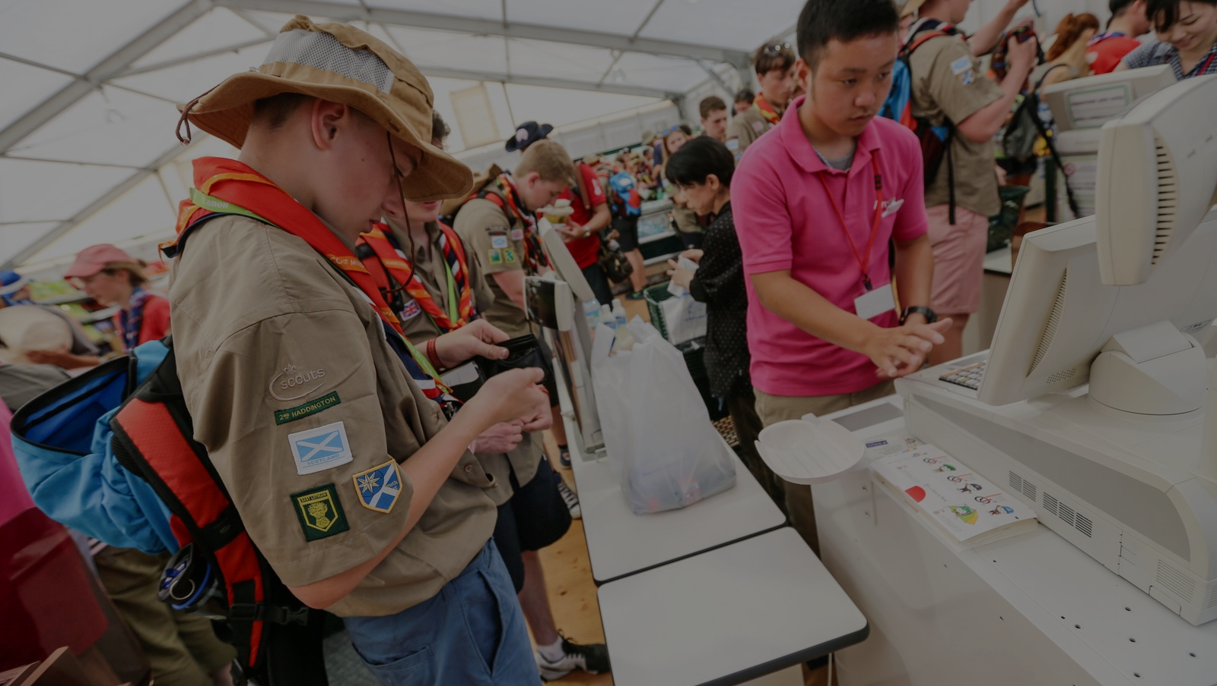
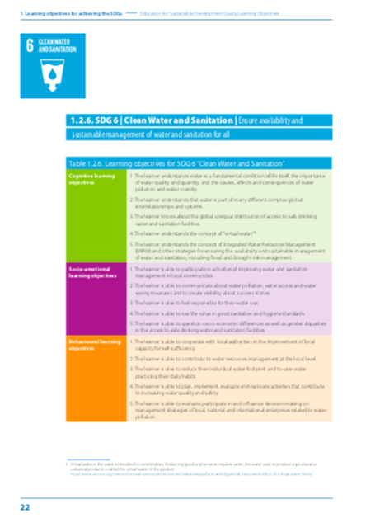
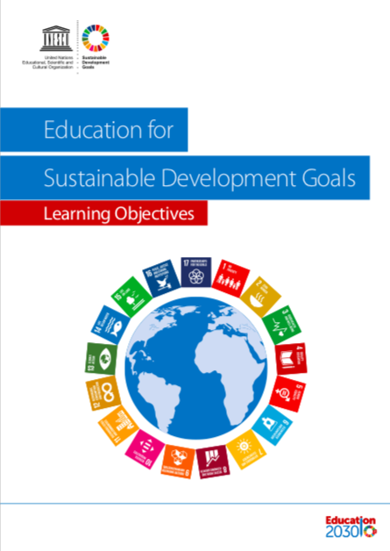
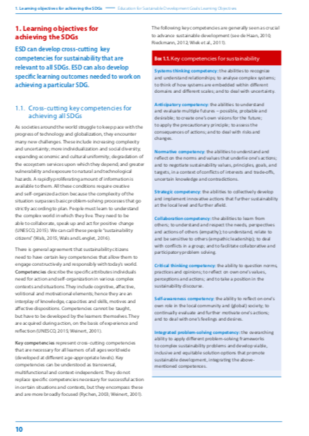
Educational Objectives and
Key Competencies

Slide 13
Some examples

Slide 14


You
can do…
You develop Sustainable
Development competencies
You
contribute to…
Self-aware
Think in systems
to see the big picture
Show critical thinking
Source: Scouts Scotland

Slide 15


You
can do…
You develop Sustainable
Development competencies
You
contribute to…
Can solve complex problems
Can strategically develop and implement innovative actions
Collaborates with others
Source: 170 daily actions to transform our world
Notes:
.

Slide 16
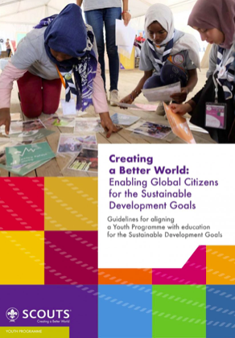
Aligning the Youth Programme with SDGs
Notes:
Identify and empathise with local issues
Select priority areas and identify needed educational objectives or programmes
Nominate someone who will take charge an seek resources and support
Get creative and choose what your approach will be
Pilot and review it according to feedback
Plan your monitoring and evaluation scheme before you star to collect data
Launch, promote, and make it accessible with suitable resources
Build the capacity of those implement it
Monitor your success and review or scale it
Share your best practices

Slide 17
1st Step
Identify areas
of alignment in your national Youth Programme
2nd Step
Plan and develop what is needed in your national Youth Programme
3rd Step
Implement and monitor your plan
Evaluate and share your story
Notes:
Identify and empathise with local issues
Select priority areas and identify needed educational objectives or programmes
Nominate someone who will take charge an seek resources and support
Get creative and choose what your approach will be
Pilot and review it according to feedback
Plan your monitoring and evaluation scheme before you star to collect data
Launch, promote, and make it accessible with suitable resources
Build the capacity of those implement it
Monitor your success and review or scale it
Share your best practices

Slide 18

A participatory approach
.
National leadership
Youth Programme team
Scout leaders
Adults in Scouting
Communications team
Partners and other relevant actors
Young people
Notes:
Young people, Scouts and non-Scouts, as key agents of the programme
Youth Programme team, as developers of the programme
Scout Leaders, as the facilitators of the programme
National leadership, to mainstream the SDGs across the organisation
Adults in Scouting team, as supporters of the programme
Communications team, as agents to help share the story
Partners, to support your education for the SDGs
Any other relevant actors

Slide 19
Aligning to the SDGs is an opportunity to:
  Become more sustainable as an institution
Offer new learning opportunities to young people
Promote Scouting to new audiences
Show Scouts how their actions impact a bigger cause
Becoming a leading non-formal educational youth movement
Reinforce the Youth Programme
Notes:
Show Scouts how their actions impact a bigger cause outside of Scouting in order to continue inspiring young people to create a better world
Offer new learning opportunities to young people and equip them with the competencies they need to find lasting solutions to the issues that affect them the most
Reinforce the Youth Programme by identifying and addressing areas of alignment
Ensure Scouting’s continued relevance by answering the current needs of young people
Help achieve Scouting’s vision to be the leading non-formal educational youth movement by being part of the global agenda for sustainable development
Promote Scouting to new audiences by showcasing Scouting’s impact on sustainable development for more than 110 years
Strengthen partnership and improve fundraising by being part of the SDG 17 – partnership for the SDG’s, and collaborating with other actors who want to see the SDG’ achieved
Become more sustainable as an institution by aligning with the SDGs across the organisation’s spheres of work

Slide 20
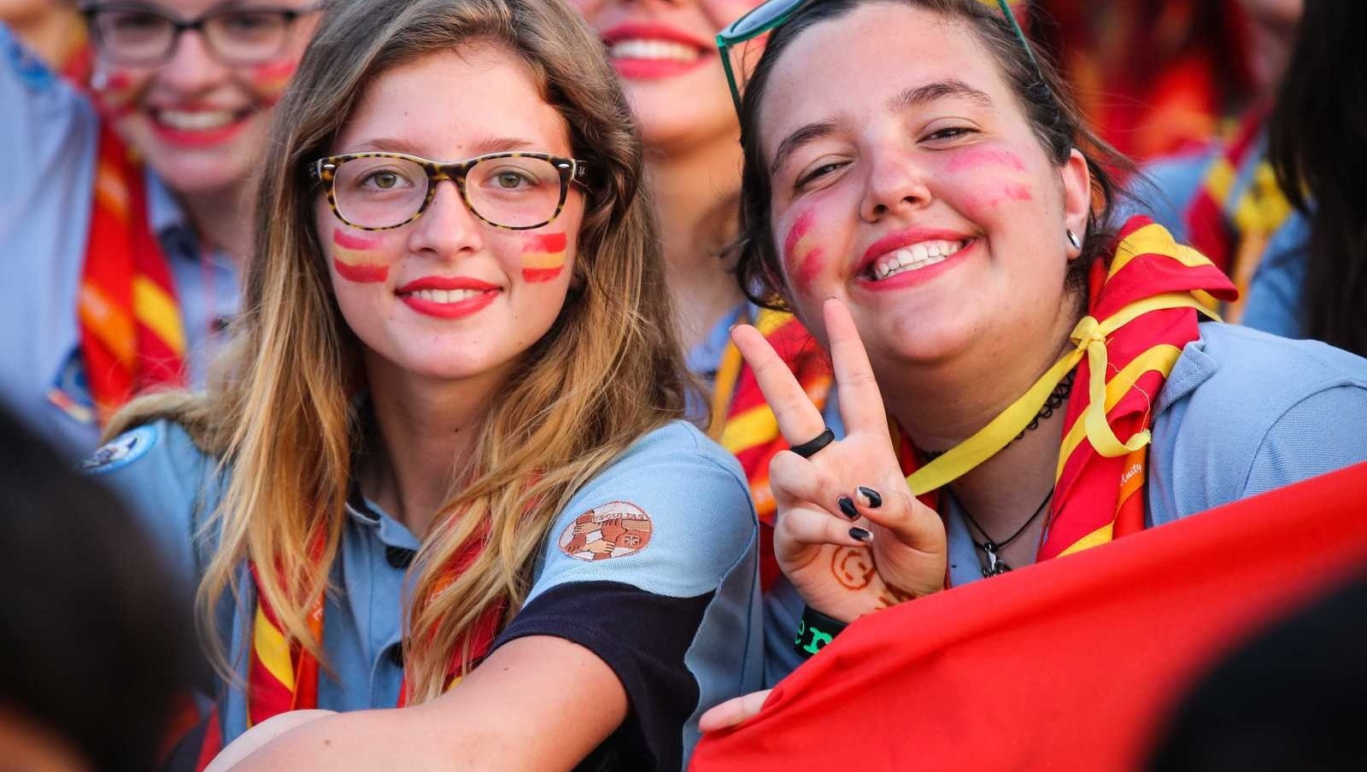
A grassroots approach
Reaching out to all: Leaving no one behind
A shared mission
Notes:
Tackling issues through a movement that is embedded in its community.
Scouting is leaving no one behind.
An agenda that helps Scouting achieve its Mission and Vision.

Slide 21



Our network of partnerships around the SDGs

Slide 22

Check out how the
Better World Framework initiatives can contribute to the SDGs.
Notes:
Show Scouts how their actions impact a bigger cause outside of Scouting in order to continue inspiring young people to create a better world
Offer new learning opportunities to young people and equip them with the competencies they need to find lasting solutions to the issues that affect them the most
Reinforce the Youth Programme by identifying and addressing areas of alignment
Ensure Scouting’s continued relevance by answering the current needs of young people
Help achieve Scouting’s vision to be the leading non-formal educational youth movement by being part of the global agenda for sustainable development
Promote Scouting to new audiences by showcasing Scouting’s impact on sustainable development for more than 110 years
Strengthen partnership and improve fundraising by being part of the SDG 17 – partnership for the SDG’s, and collaborating with other actors who want to see the SDG’ achieved
Become more sustainable as an institution by aligning with the SDGs across the organisation’s spheres of work

Slide 23
#SCOUTS4SDGS
THANK YOU!

